Slide 1
Lone Wolf (Jeevesh Mahajan)
Advolution 7.0
Code Link

Slide 2
Approach
Dataset pre-processing and filling missing values (analysis and imputing).
Division of dataset into main team and substitute team players along with assigning playing positions.
Building optimization model taking care of constraints.
Relevant visualizations for analysis and verification.

Slide 3
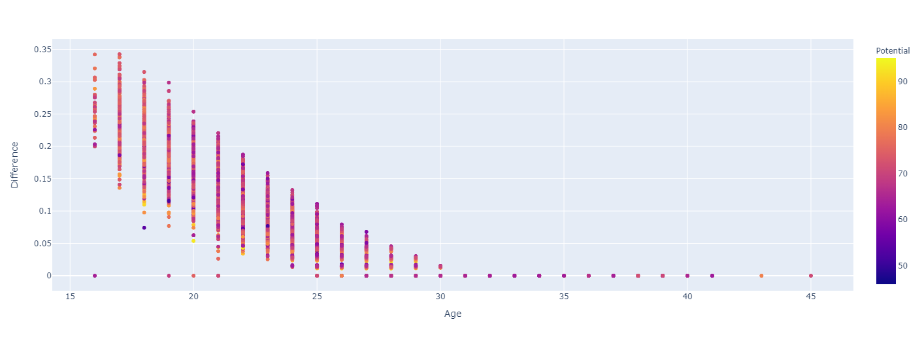
Dataset pre-processing
The most important column [‘Overall’] had 194 missing values which had to be filled analytically.
The column [‘Potential’] had all values present so a comparison of [‘Overall’] and [‘Potential’] is made by taking percentage difference of the above and comparing its variation with age since it is the most important feature which represents when performance of a player peaks.

Slide 4
The missing value of the column [‘Overall’] can be filled using the previous approach.
The following columns are removed either they provide insignificant information or have many missing values. ["International Reputation", "Weak Foot", "Skill Moves", "Work Rate", "Body Type", "Jersey Number", "Joined", "Contract Valid Until", "Height", "Weight", "Marking", "Best Overall Rating"].
The remaining player attributes have only few missing values which can be filled by KNNImputer() which is an imputation technique that uses mean value from k-nearest neighbours to that datapoint (this is done taking care of the fact that attributes belonging to particular set are highly correlated to each other which can be verified using a heatmap).

Slide 5
Division of Dataset
The main team players and substitute players are divided into two different datasets for easy application of the optimization model.
Along with it the playing position is also specified:
# goalkeeping positions
goal_pos = ['GK’]
# defensive positions
def_pos = ['CB', 'LB', 'RB', 'LCB', 'RCB', 'LWB', 'RWB’]
# midfield positions
mid_pos = ['LM', 'RM', 'CM', 'CAM', 'CDM', 'LAM', 'LCM', 'LDM', 'RCM', 'RAM', 'RDM’]
# attacking positions
att_pos = ['CF', 'RF', 'LF', 'ST', 'LS', 'RS', 'LW', 'RW’]
# substitute positions
sub_pos = ['SUB', 'RES’]
Thus we get a new dataset specifying whether a player is a main team player or substitute team player along with their mapped playing position.

Slide 6
Optimization Model
Using a python library for linear optimization (PuLP) we can get solution to our problem specifying the variables, objective and constraints.
1. Variables:
# Helper Variables
POS = All the unique positions in data
CLUB = All the unique clubs in data
NATIONALITY = All the unique nationality in data
# Initialize Variables
names = Extract name of all players
teams = Extract clubs of all players
positions = Extract position of all players
rating = Extract rating of all players
countries = Extract nationality of all players
foot = Extract preferred foot of all players

Slide 7
2. Objective:
prob = Maximize rating of the team
3. Constraints:
# Left-footed
prob += At least one left-footed player
# Position Limit
prob += At max the specified number of players at the specified position
# Club Limit
prob += At max one player from particular club
# Nationality Limit
prob += At max one player from particular country
Solution:
solution = Solve objective using PuLP linear optimizer

Slide 8
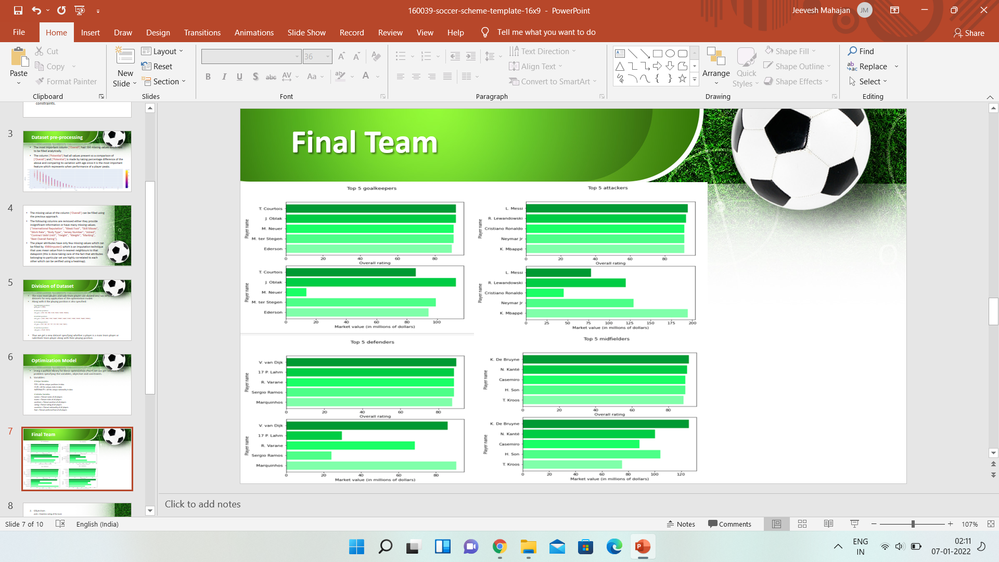
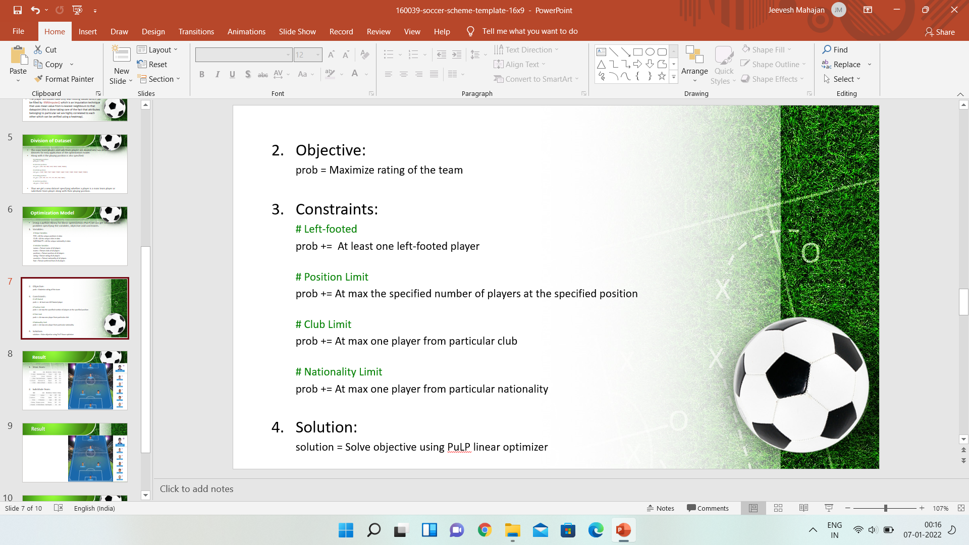
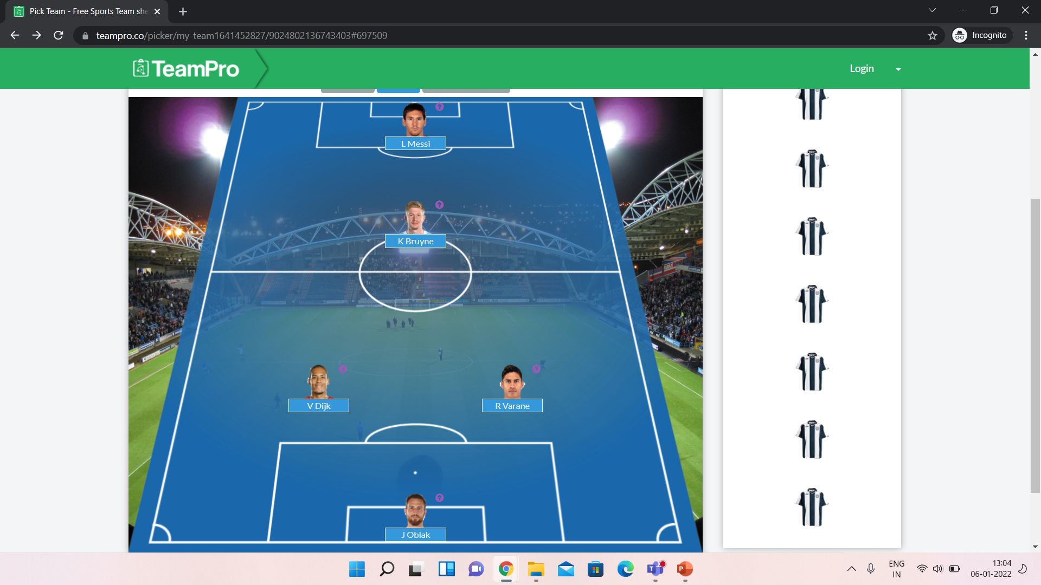
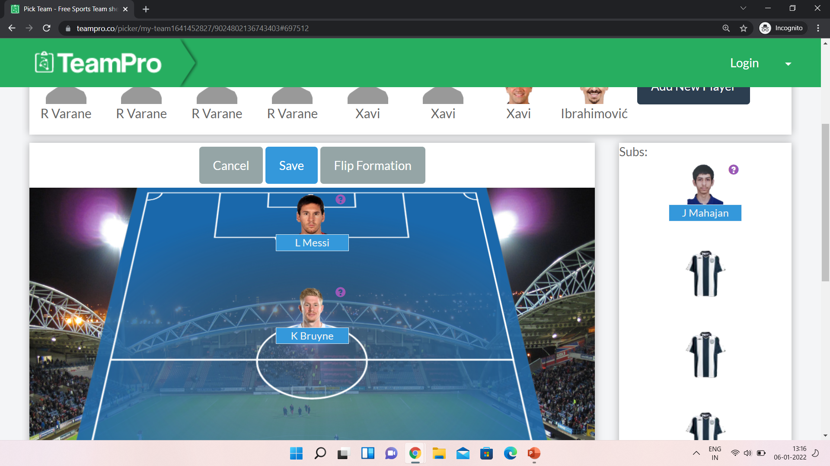
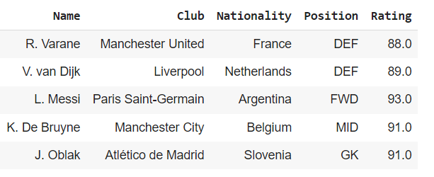
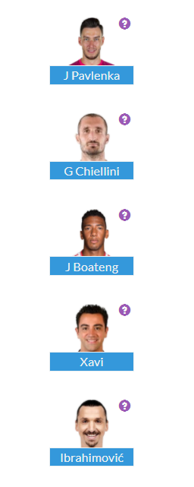
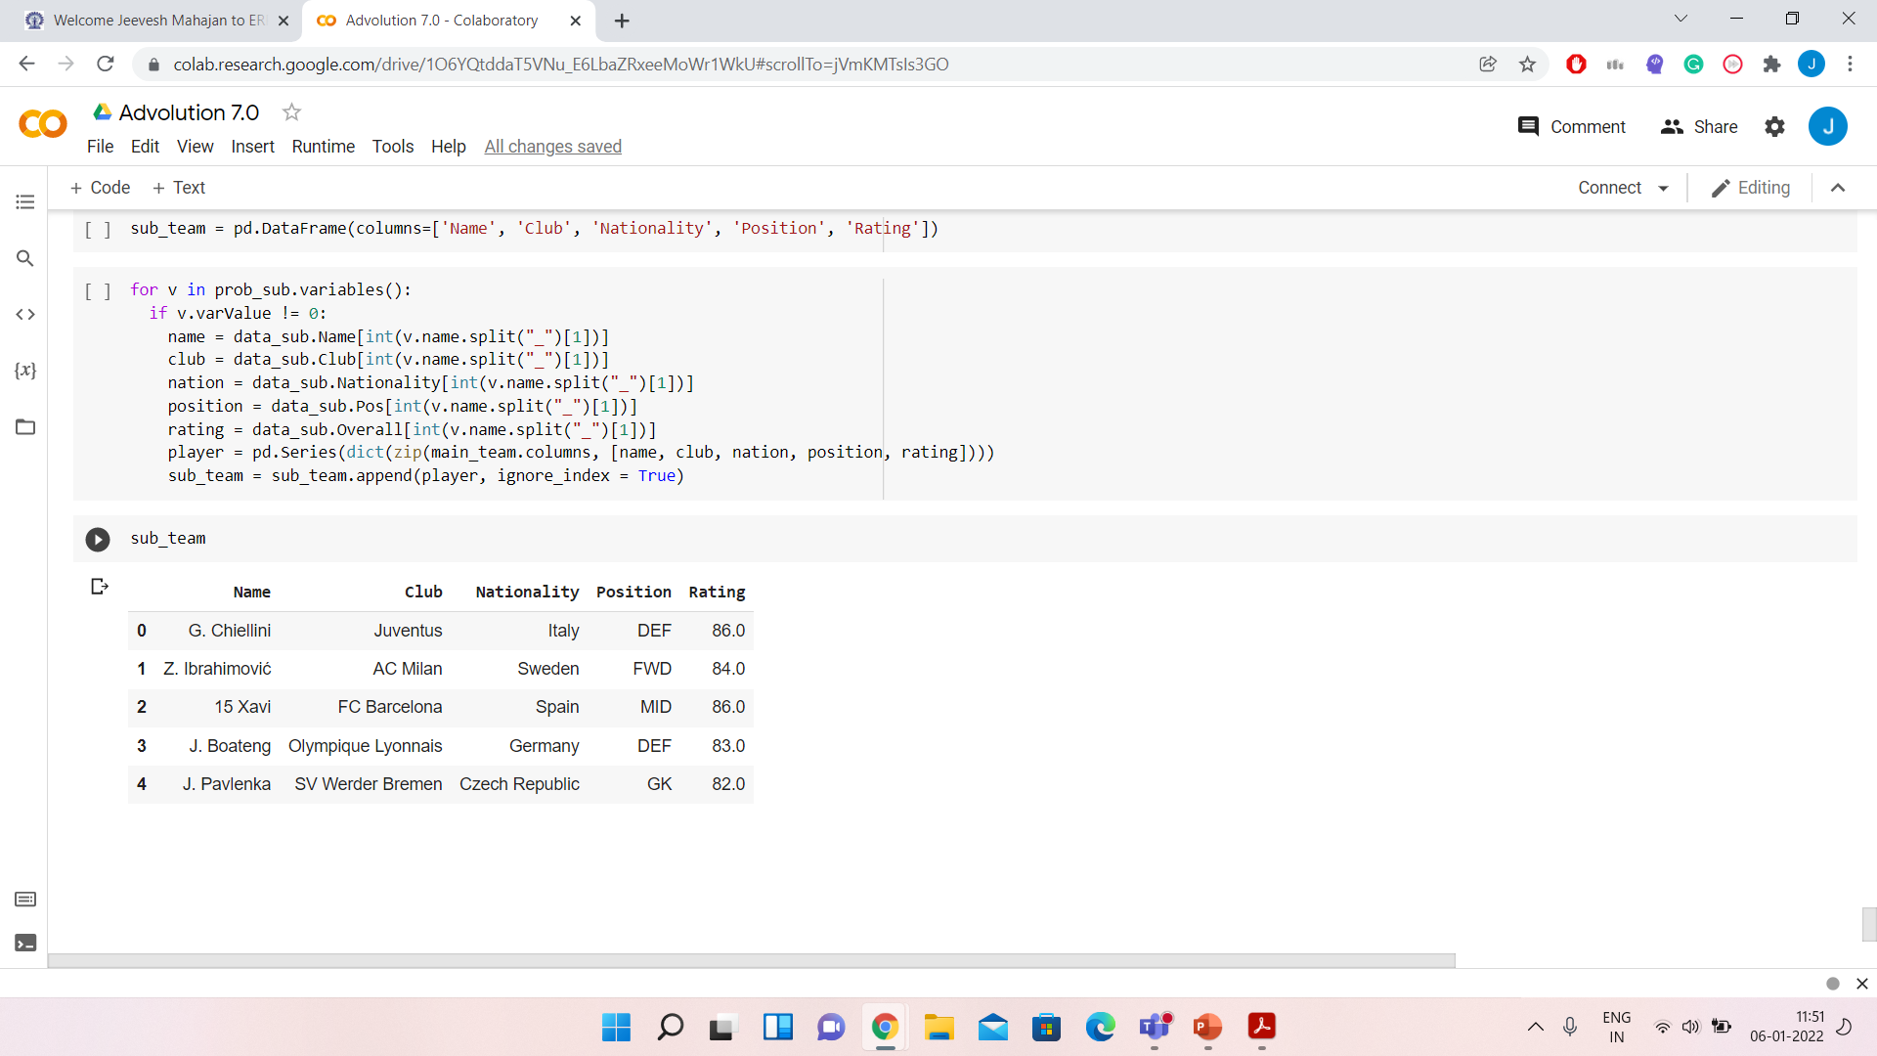
Main Team:
2. Substitute Team:

Slide 9
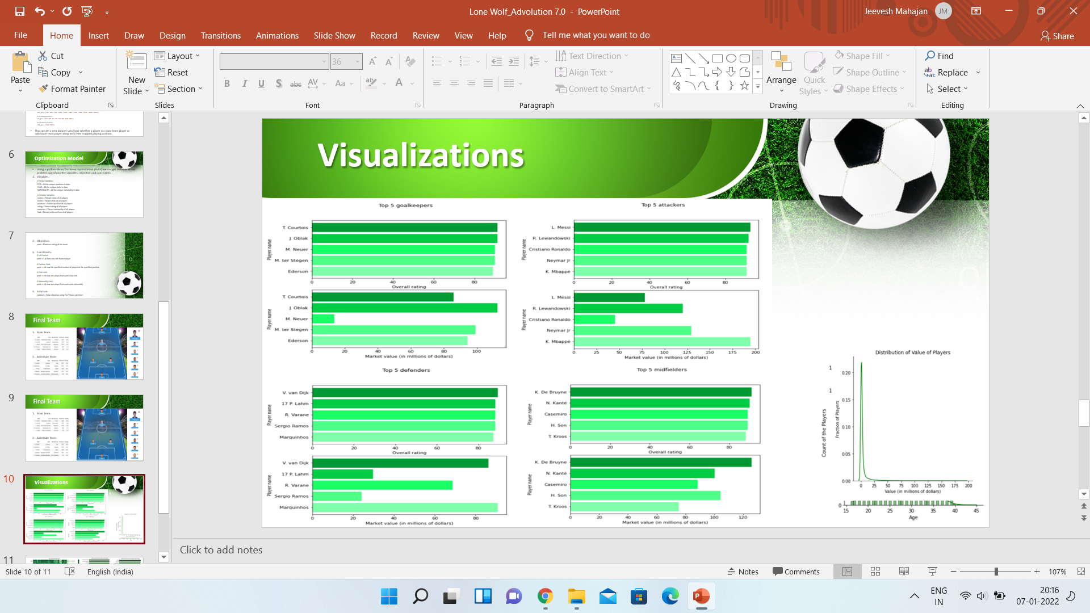
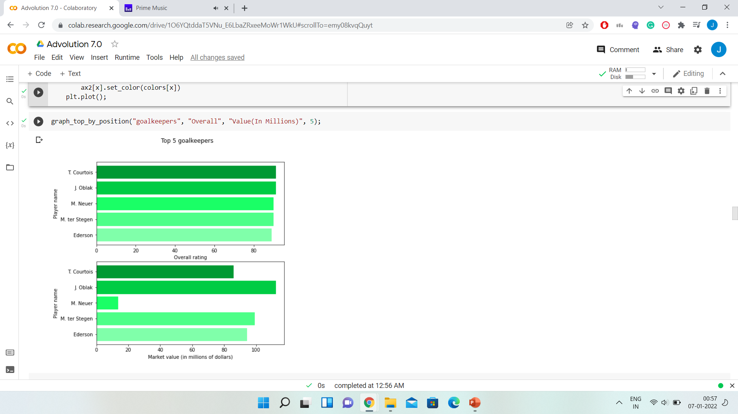
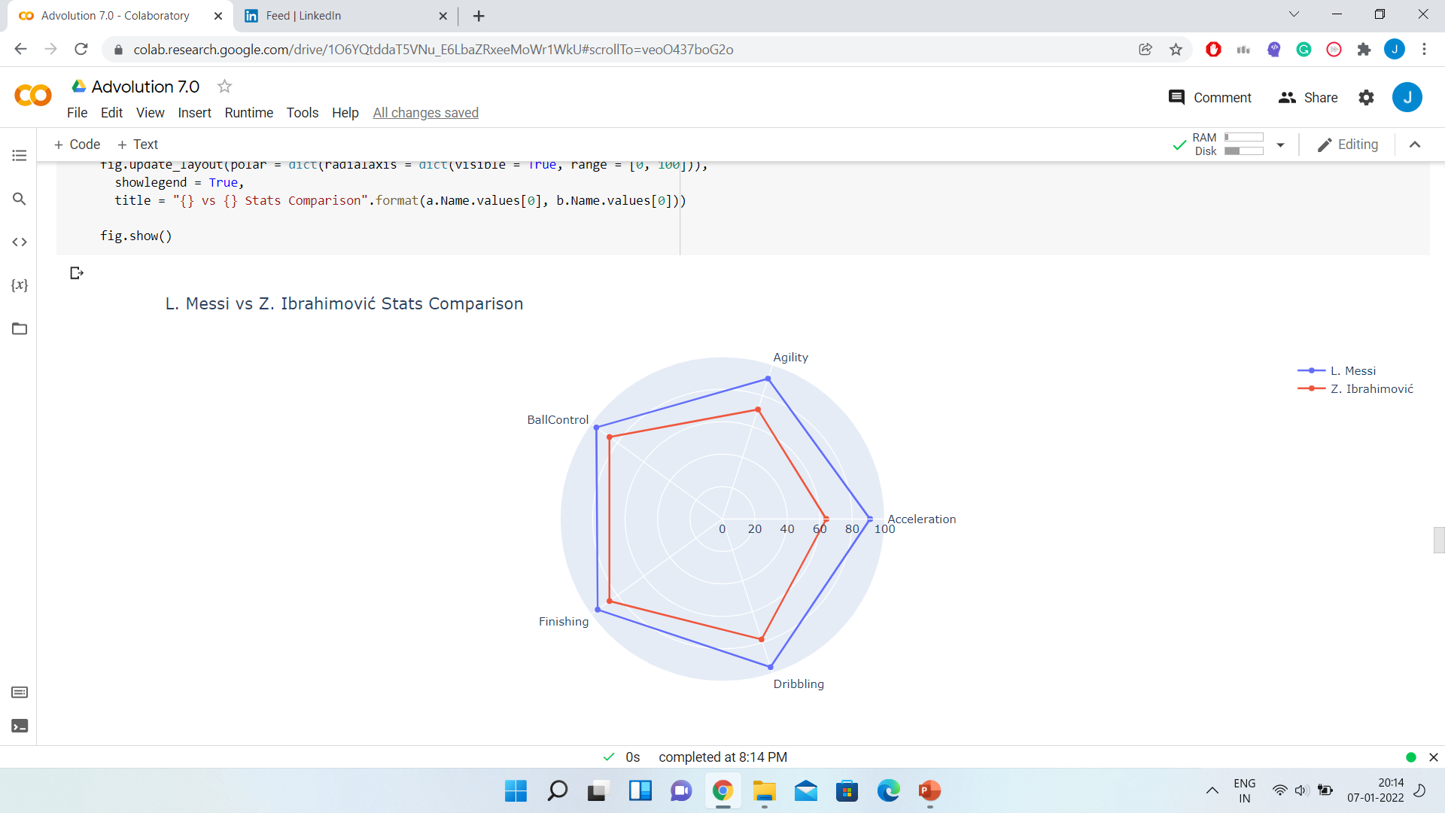
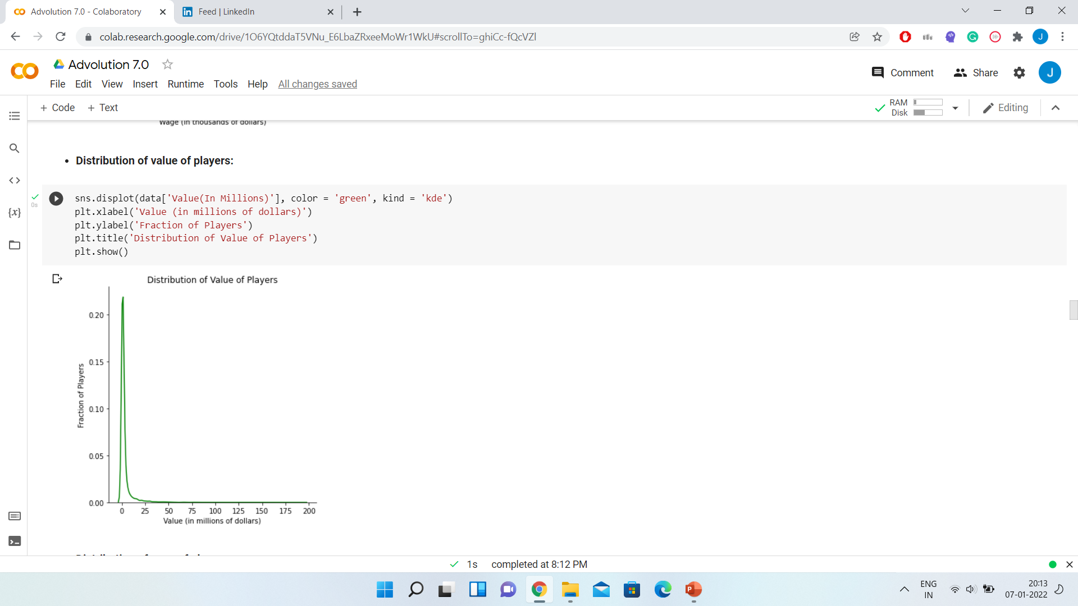
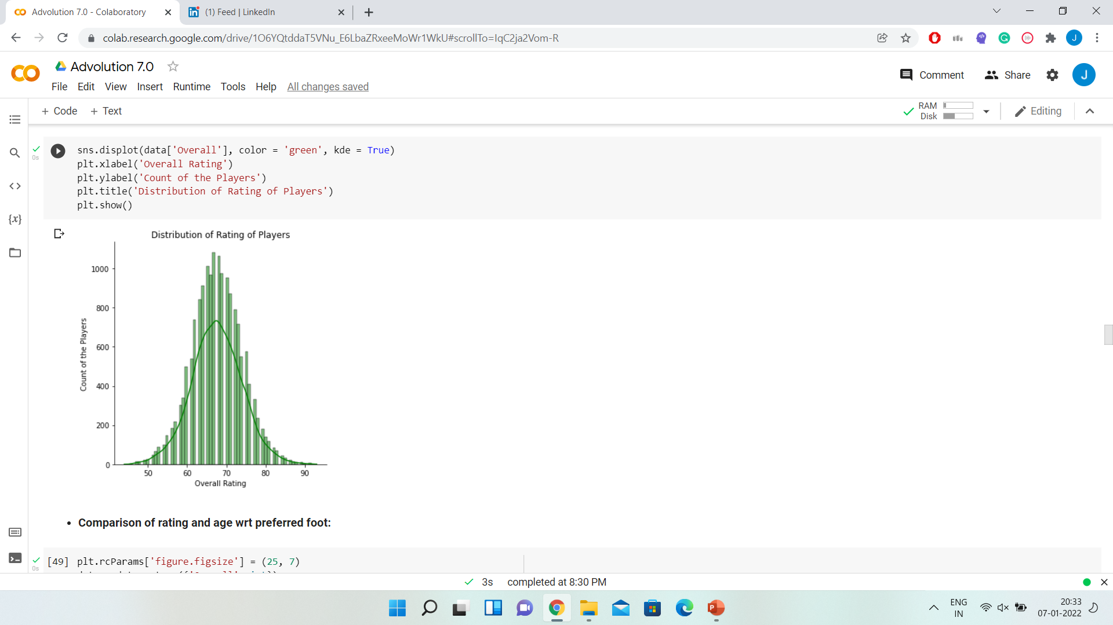
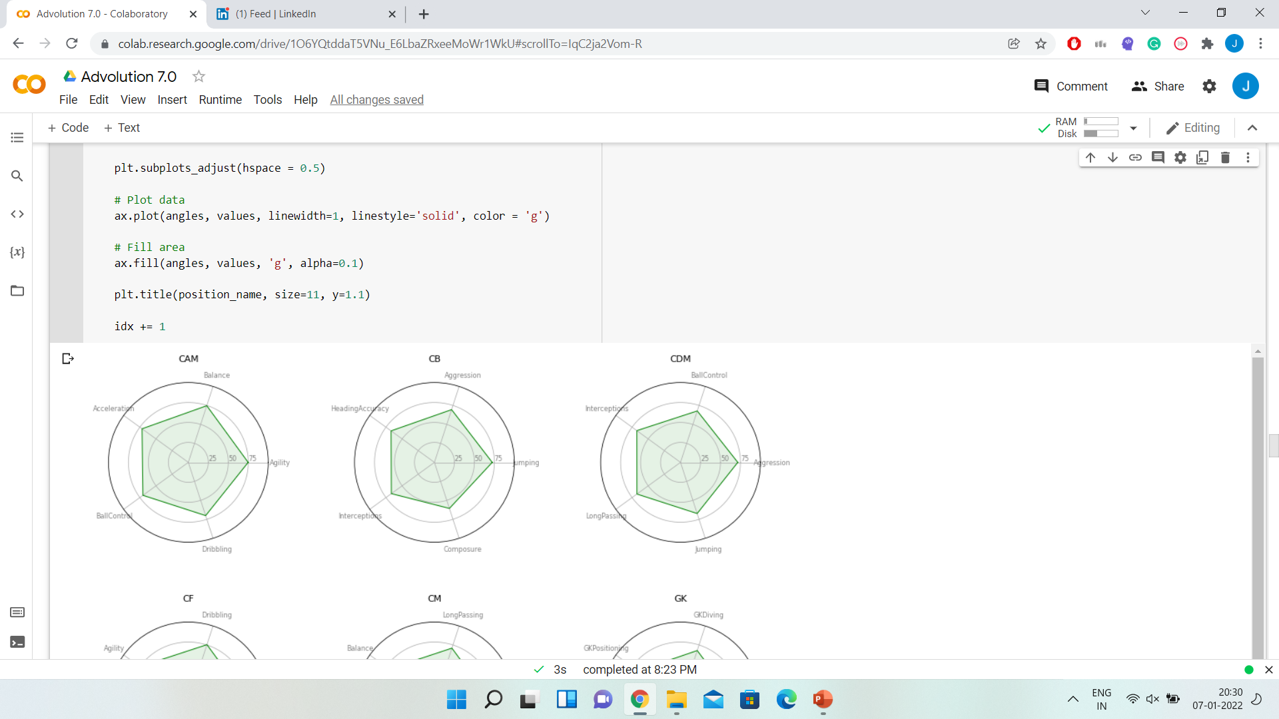

Slide 10
